Slide 1

System & Network Administration
By eman mehmood

Slide 2
System & Network Administration
BS Information Technology – 5th Semester
Department of Information Technology
Government College University
Lecture 5: File systems, permissions, storage, and disk management

Slide 3
Introduction to File Systems, Permissions, Storage, and Disk Management
A computer system stores a large amount of information, including operating system files, applications, user documents, databases, and configuration files. To manage this information efficiently, system administrators must understand how file systems organize data, how permissions control access, and how storage devices are configured and maintained.
File system management ensures that data is stored in an organized manner and can be retrieved whenever required. Permission management protects sensitive information from unauthorized access, while storage and disk management help administrators monitor available space, allocate storage resources, and maintain system performance.
These activities are essential responsibilities of system and network administrators because improper storage configuration or access control can lead to data loss, security vulnerabilities, and system failures.

Slide 4
What Is a File System?
A file system is a method used by an operating system to organize, store, name, retrieve, and manage files on a storage device. It provides a structured way to arrange information so that users and applications can access data without needing to understand how the information is physically stored on a disk.
When a user saves a document, installs software, or creates a folder, the operating system uses the file system to determine where the data should be stored and how it can be accessed later.
A file system also maintains important information such as file names, file sizes, creation dates, modification times, and storage locations. Without a file system, managing large amounts of information on a storage device would be extremely difficult.
Example: When a student saves a file named Assignment.docx in the Documents folder, the file system records its location and associated information so that the operating system can retrieve it when needed.

Slide 5
Structure of a File System
A file system organizes data into a hierarchical structure consisting of drives, directories, subdirectories, and files. This structure allows users and administrators to arrange information logically and locate specific files efficiently.
A directory, commonly called a folder, is a container used to organize files and other directories. A subdirectory is a directory located inside another directory. Files are the actual units of stored information, such as documents, images, programs, and configuration data.
In Windows, storage devices are commonly represented by drive letters such as C:, D:, and E:. In Linux, all files and directories are organized under a single root directory represented by /.

Slide 6
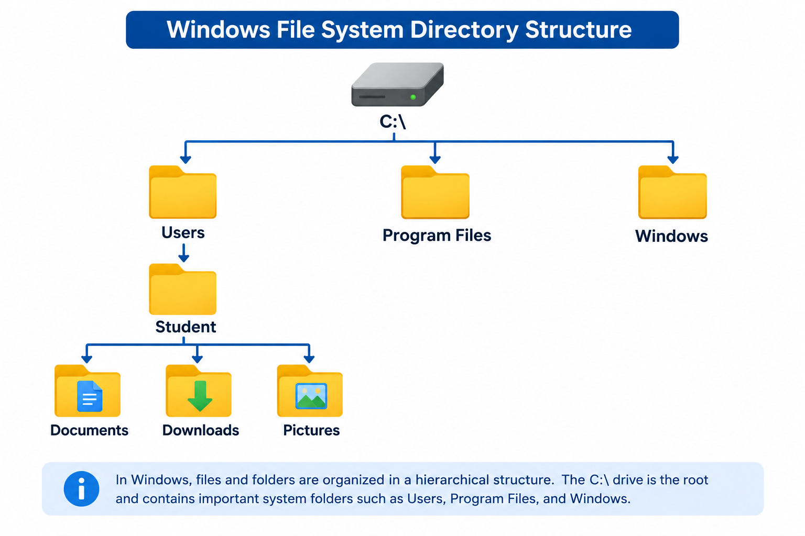
Example of a Windows directory structure:

Slide 7
Types of File Systems
Different operating systems support different file systems depending on their requirements for performance, security, compatibility, and storage capacity.
NTFS (New Technology File System) is the standard file system for modern Windows installations. It supports file permissions, encryption, compression, large storage volumes, and journaling, making it suitable for personal computers and enterprise servers.
FAT32 (File Allocation Table 32) is an older file system commonly used in USB drives and devices that require broad compatibility. However, it has a maximum individual file size of 4 GB, which limits its usefulness for large files.
exFAT (Extended File Allocation Table) is designed for flash storage devices and supports large files while maintaining compatibility across many operating systems.
ext4 (Fourth Extended File System) is widely used in Linux distributions. It supports journaling, large volumes, file permissions, and efficient storage management.
XFS is a high-performance Linux file system commonly used in servers and environments that handle large files and heavy workloads.

Slide 8
Comparison of Common File Systems
Feature | NTFS | FAT32 | exFAT | ext4
Common usage | Windows systems | USB drives | Flash storage | Linux systems
File permissions | Yes | No native permissions | No native permissions | Yes
Journaling | Yes | No | No | Yes
Maximum individual file size | Very large | 4 GB | Very large | Very large
Compression | Supported | Not supported | Not supported | Not natively supported
Encryption | Supported | Not supported | Not supported | Depends on configuration
Typical application | Operating system drives | Older devices | External drives | Linux servers

Slide 9
File System Formatting
Formatting is the process of preparing a storage device or partition for storing data by creating a file system. During formatting, the operating system establishes the structures required to organize and manage files.
Administrators may format a new hard drive, prepare a USB drive, or change an existing partition to a different file system. However, formatting a partition can erase its existing data, so important information must be backed up before the operation.
There are two common types of formatting. Quick formatting creates the required file system structures without performing a complete sector-by-sector scan. Full formatting takes longer and, depending on the operating system, may also check the storage device for problematic sectors.
Windows example: Administrators can format a drive through Disk Management by right-clicking a volume and selecting Format.

Slide 10

Continue…
Linux example:
This command creates an ext4 file system on the specified partition. It should only be executed after verifying the correct device because formatting the wrong partition can destroy important data.

Slide 11
File and Directory Management
File and directory management refers to creating, organizing, copying, moving, renaming, and deleting files and folders. These operations help administrators maintain an organized system and ensure that information is stored in appropriate locations.
In a multi-user environment, administrators often create separate directories for departments, projects, and individual users. This arrangement makes it easier to apply permissions, perform backups, and locate information.
For example, a university server may contain separate directories for students, faculty members, examination records, and administrative documents. Organizing these resources into clearly defined folders reduces confusion and supports efficient management.
Linux provides command-line utilities for these operations, while Windows supports both graphical tools and command-line interfaces such as Command Prompt and PowerShell.

Slide 12
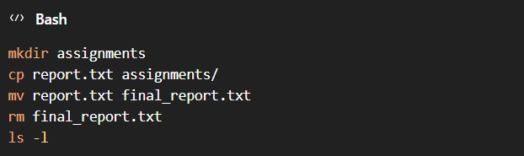
Continue…
Linux commands:
These commands create a directory, copy a file, rename a file, remove a file, and display directory contents.

Slide 13
Introduction to File Permissions
File permissions define which users can access files and directories and what operations they are allowed to perform. They are an important component of operating system security because they prevent unauthorized users from modifying, deleting, or viewing sensitive information.
In a multi-user operating system, not every user should have unrestricted access to every file. For example, a student should be able to access personal assignments but should not be allowed to modify system configuration files or another student's private documents.
Permissions help administrators enforce the principle of least privilege, which means providing users only the access necessary to perform their assigned responsibilities.
Windows and Linux use different permission models, but both provide mechanisms for controlling access to files and directories.

Slide 14
Types of File Permissions in Linux
Linux uses three basic permission types: read, write, and execute. These permissions determine how users can interact with files and directories.
Read (r): Read permission allows a user to view the contents of a file. For a directory, it allows the user to list its contents, subject to the necessary directory traversal permissions.
Write (w): Write permission allows a user to modify a file. For a directory, it allows the user to create, rename, and delete entries, subject to other applicable restrictions.
Execute (x): Execute permission allows a user to run an executable file or script. For a directory, it allows the user to traverse the directory and access items within it when other permissions permit.

Slide 15
Continue…
Linux represents these permissions using letters and numerical values.
Permission | Symbol | Numeric value
Read | r | 4
Write | w | 2
Execute | x | 1
No permission | - | 0

Slide 16
User, Group, and Others in Linux
Linux permissions are assigned to three categories: owner, group, and others. This arrangement allows administrators to control access for individual users as well as groups of users.
The owner is the user who owns the file or directory. The owner can be granted specific permissions independently of other users.
The group represents a collection of users who share access rights. For example, all members of a university's Computer Science department may belong to a common group that has access to departmental resources.
The others category includes all users who are neither the file owner nor members of the file's assigned group.

Slide 17
Continue…
Consider the following permission display:
The first character indicates that the object is a regular file. The next three characters (rwx) represent the owner's permissions, r-x represents the group's permissions, and r-- represents the permissions for others.
In this example, the owner can read, modify, and execute the file; group members can read and execute it; and other users can only read it.

Slide 18
Understanding Linux Permission Numbers
Linux also represents permissions through a numerical system called octal notation. Each permission has a numerical value, and the values are added together to determine the final permission for each category.
For example, read permission has a value of 4, write permission has a value of 2, and execute permission has a value of 1. Therefore, read and write permissions together equal 6, while read and execute permissions equal 5.
Consider the permission 755. The first digit represents the owner, the second represents the group, and the third represents others.
Owner: 7 = read + write + execute.
Group: 5 = read + execute.
Others: 5 = read + execute.
Similarly, permission 644 allows the owner to read and modify a file, while group members and others can only read it.

Slide 19
Continue…
Common permission values:
Administrators should avoid unnecessarily granting broad permissions, particularly on shared servers.
Permission | Meaning
777 | Everyone has read, write, and execute access
755 | Owner has full access; group and others have read and execute
700 | Only the owner has full access
644 | Owner can read and write; others can read
600 | Only the owner can read and write

Slide 20

Managing Linux Permissions Using chmod
The chmod command is used to change the permissions of files and directories in Linux. System administrators use it to control which users can read, modify, or execute specific resources.
The command supports both numerical and symbolic methods. Numerical notation is useful when assigning a complete permission set, while symbolic notation is convenient for making individual changes.
This command gives the owner full permissions and grants read and execute permissions to the group and others.

Slide 21



Continue…
This command allows the owner to read and modify the file while allowing other users to read it.
This command adds execute permission for the file owner.
This command removes write permission from the group.

Slide 22


